Slide 1
Modular Programming(10-dars)
Davronbek Malikov

Slide 2


Bugun
Project 4 va savol javob
Data Preprocessing+Training Pipeline
Pipeline + Logging+Boshqalar
Pipeline + Logging: Amaliy
Class vs Pipeline
Class vs Pipeline: Amaliy
Vazifa

Slide 3
Project 4 va savol javob

Slide 4
Takrorlash

Slide 5

Takrorlash
Project 3: Discussion
Takrorlash
Data Preprocessing Pipeline:
Manual
Auto
Data Preprocessing amaliy
Vazifa

Slide 6

Data Preprocessing+Training Pipeline

Slide 7
Data Preprocessing Pipeline
Data loading+Data Preprocessing:
Manual
Auto

Slide 8

Data Preprocessing Pipeline
Simpleimputer---handling missing values
Numeric data:
"mean" → replace NaN with column mean
"median" → replace NaN with column median
"most_frequent" → replace NaN with most frequent value
"constant" → replace NaN with a fixed value you define (fill_value)
Categorical data:
"most_frequent" is common“
constant" with fill_value="missing" is also useful

Slide 9
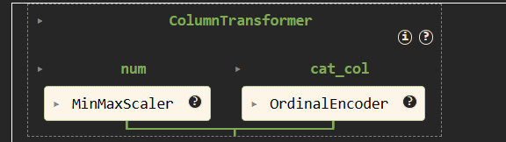

Data Preprocessing Pipeline

Slide 10
Data Preprocessing amaliy

Slide 11
Model Training Pipeline

Slide 12
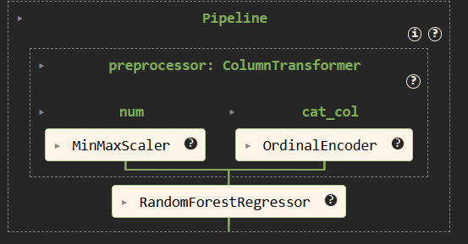

Model Training Pipeline
Preprocessor+Algorithm

Slide 13
Model Training Pipeline amaliy

Slide 14
Pipeline + Logging+Boshqalar

Slide 15
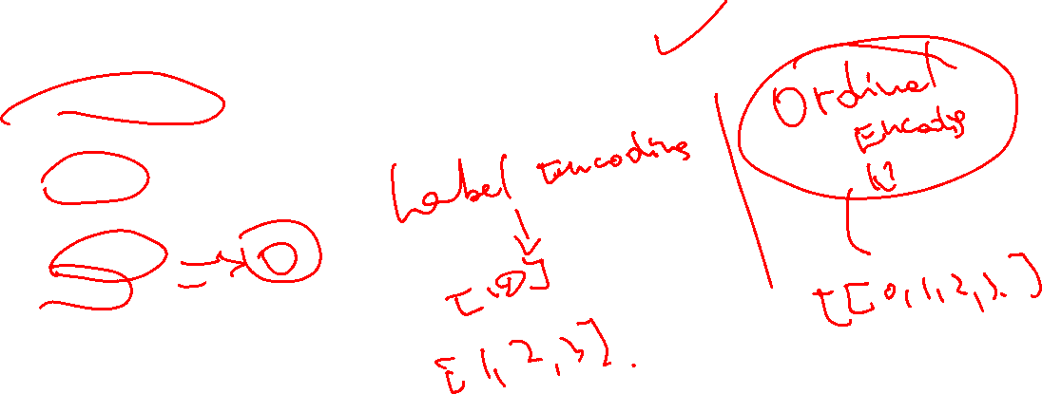
Pipeline + Logging+Boshqalar
Pipeline orqali qilinganda xam logging ishlaydi
Preprocessingda:
Encoding:
One-Hot
error(default)
ignore
Ordinal
error(default)
use_encoded_value

Slide 16
Pipeline + Logging: Amaliy

Slide 17
Class vs Pipeline

Slide 18
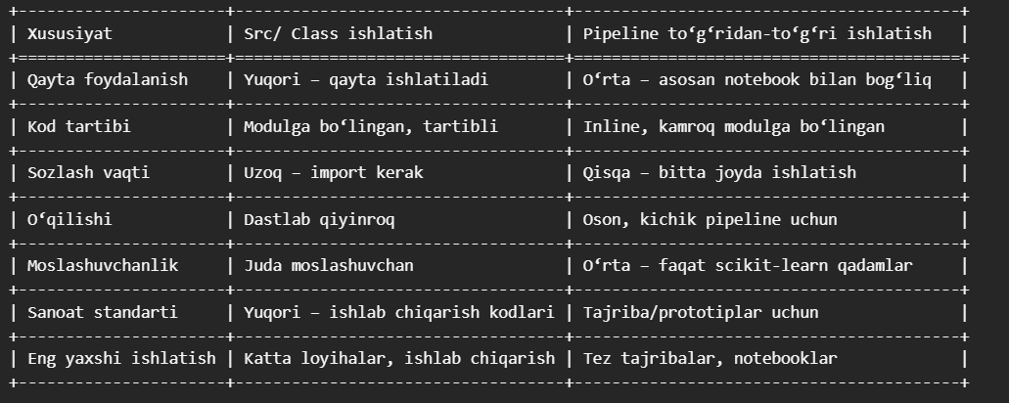

Class vs Pipeline
Class vs Pipeline

Slide 19

Class vs Pipeline
Scikit-learn Pipelines
Standard va qisqaroq kodlar
Automatlashtirish oson
Inson xatosini kamaytiradi
Manual(Custom Classes)
Complex preprocessing yaratish(scikit-learnda mavjud bolmagan)
Custom metriklarni jalb qilishda
Mix
Ikkala xolatdan xam foydalanish eng yaxshi practise

Slide 20
Class vs Pipeline: Amaliy

Slide 21
Vazifa

Slide 22

Vazifa
10-dars uchun report yozing
Project 4 ga finalga tayyorlang
Class+Pipeline orqali kichikroq dataset orqali model yasang

